Slide 1
CS 573 Advanced Software Engineering
Class Design

Slide 2
Textbooks
Bertrand Meyer. Object-Oriented Software Construction, 2nd Edition, Prentice-Hall PTR, 1997. Chapters 22 and 23.
Steve McConnell. Code Complete: A Practical Handbook of Software Construction. 2nd Edition. Microsoft Press, 2004. Chapter 6.

Slide 3
Review of Design Concepts
Aim at high cohesion and loose coupling
Encapsulate implementation details
Abstractions & abstract data types
Information hiding
Inherit when possible and reasonable
Look for design patterns
Identify areas likely to change

Slide 4
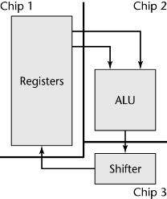
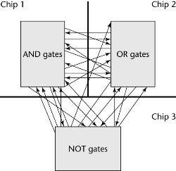
Cohesion and Coupling
Coupling
Degree of interaction between modules
Cohesion
Degree of interaction within a module
Ideal cohesion:
information cohesion for classes (ADT)
Function cohesion (one action) for methods

Slide 5
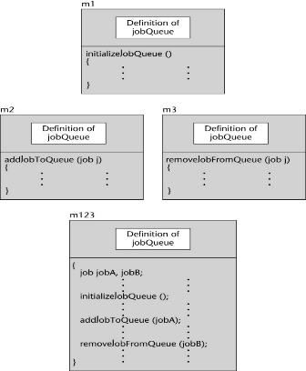
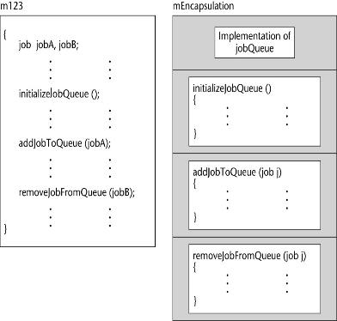
Encapsulation
operations on job queues are spread all over
operations on job queues are encapsulated into one module

Slide 6
Abstract Data Type (ADT)
Need to specify essential properties of objects
Precise, non-ambiguous
Complete - or at least as complete as we want
Non - over-specifying
Over-specifying: too much information for the clients, e.g. details of representation
ADT
A collection of data and operations on that data
Use ADTs to manipulate real-world entities rather than low-level, implementation entities
Create classes that are easier to implement initially and to modify over time

Slide 7
ADT: Stack
Notes:
Total function: applicable to all members of the domain
Partial function: not applicable to all members of the domain

Slide 8
Functions/Methods
Creator function- constructor
The type being defined appears only to the right of the arrow
new
Query function - accessor
The type being defined appears only on the left of the arrow
peek, empty
Command function – modifier/mutator
Appears on both sides of the arrow
push, pop

Slide 9
ADTs vs Classes
A class is an ADT equipped with a possibly partial implementation
An ADT specification (public interface)
A choice of representation (e.g., data structures).
A mapping from ADT functions to method implementations
Each method implements one of the functions in terms of the representation
The methods satisfy the axioms and preconditions.

Slide 10
The Stack Class in Java
public class Stack<E> extends Vector<E>
Stack is a generic class, E is type parameter
Constructor
Stack()
Methods
public E push(E item)
public E pop()
public E peek()
public boolean empty()
public int search(Object o)

Slide 11
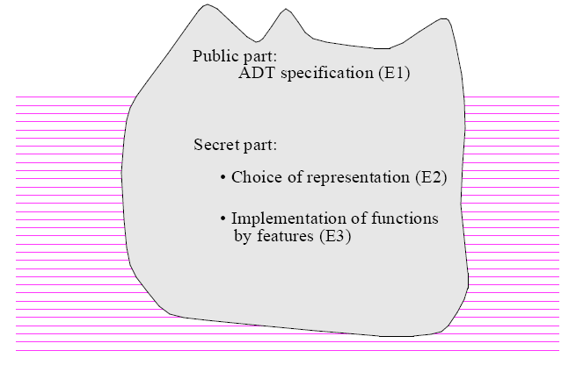
ADT & Information Hiding

Slide 12
Outline
Finding Classes from Requirements Document
Danger Signals
Heuristics for Finding Classes
Obtaining Classes: Summary
Side Effects in Functions
Good Class Interfaces
How Many Arguments for a Function/Method?
Class Size: The Shopping List Approach

Slide 13
Finding Classes
Central decision in object-oriented software
It takes talent and experience, not to mention luck.
You should not expect too much – expecting infallible recipes for finding classes is unrealistic
Motivation of a methodological discussion
Indicate some good ideas
Draw your attention to some illuminating precedents
Alert you to some known pitfalls
Selection technique
What to consider; What to reject

Slide 14
Finding Classes from Requirements
The elevator will close its door before it moves to another floor.
Function-oriented design
Concentrate on the verbs – actions
Move, close
Object-oriented design
Underline the nouns – objects
Elevator, Door, Floor – voila
Danger!
Requirements in a natural language are open to nuance, personal variation and ambiguity

Slide 15
Avoiding Useless Classes
The nouns method covers some classes of the final design.
The method includes many “false alarms” also concepts should not yield classes
Do we need class Door?

Slide 16
Do We Need Class Door? No
The only relevant property: opened/closed
It suffices to have methods in Elevator
boolean: door_open;
void closeDoor (){
…
// postcond: not door_open
}
void open_door(){
…
// postcondition: door_open
end

Slide 17
Do We Need Class Door? Maybe
The notion of door may be important enough to justify a separate class.
Theory of ADTs – helps ask customers the right questions
Is “door” a separate data type with its own clearly identified operations? or
Are all the operations on doors already covered by operations on other data types such as Elevator?

Slide 18
Do We Need Class Floor?
Floors are definitely an important data abstraction for an elevator system.
What properties?

Slide 19
Is a New Class Necessary?
Unnecessary - floor properties may be entirely covered by those of integers.
Floor number, distance between two floors
Appropriate - significant operations not covered by those of integers
Some floors may have special access rights defining who can visit them
Need access rights and associated procedures
More properties: subtract/compare two floors, but not to add or multiply them.

Slide 20
ADT View as the Right Criterion
Do the objects exhibit enough specific operations and properties of their own, relevant to the system and not covered by existing classes?

Slide 21
Missing Important Classes - cont
A database record must be created every time the elevator moves from one floor to another.
Class Database-Record is suggested
Move between two floors is important
class Move {
Floor initial, final; // or int if no Floor class
void record (d: Database) {
}
… other methods …
}

Slide 22
Why Are Classes Missing
Flexibility and ambiguity of human language
A database record must be created for every move of the elevator from one floor to another.
Some crucial abstractions may not be directly deducible from the requirements
A strategy that uses requirements doc as the basis for analysis often overlooks reuse.
Some abstractions are likely to be found in existing software, not in the requirements document for a new project.

Slide 23
Discovery and Rejection
Lesson 1: Do not put too much trust in a requirements document; do not put any trust in grammatical criteria.
Lesson 2: Eliminating bad ideas as important as finding good ones
Concepts may initially appear promising but end up not justifying a class of their own.
We need criteria for rejecting candidate classes
Class Elicitation Principle
Elicitation is a dual process: suggestion, rejection.

Slide 24
Danger Signals
Signs of a bad choice, not proof!
The grand mistake – designing a class that isn’t
OOD: build modules around object types, not functions
Each class corresponds to a meaningful data abstraction
“This class prints the results”
“This class parses the input”
“This class does …”
A class is not supposed to do one thing but to offer a number of services on objects of a certain type.

Slide 25
Danger Signals - cont
Imperative class names
A verb in the imperative or infinitive, e.g. Parse or Print should catch your attention
Either its name is wrong or it ‘does one thing’
Class name rule
A noun, possibly qualified.
An adjective (only for an abstract class describing a structural property), e.g. Comparable
Possible exception
Command classes – action abstractions
Stick to the rule – LineDeletion vs DeleteLine

Slide 26
Danger Signals - cont
Single-method classes
Only one public method, possibly calling a few private ones.
Possible exception: interactive command
Premature classification
Instances vs heirs
SanFrancisco and Houston inherit from City

Slide 27
Danger Signals - cont
No-command classes
Queries only, equivalent of a record/structure
Need to probe
A class may describe non-modifiable objects – e.g. obtained from the outside world (sensor)
Some classes are meant for encapsulating facilities e.g. constants, Java String
Mixed abstractions
EmpolyeeCensus is-a ListContainer
Class consistency principle: all the features of a class must pertain to a single, well-identified abstraction.

Slide 28
The Ideal Class
Clearly associated abstraction
Name: noun or adjective
Adequately characterizing the abstraction.
Class represents a set of run-time objects
Some meant to have only one instance are acceptable
Queries for finding out properties of an instance.
Commands for changing the state of an instance.
Abstract properties can be stated, describing:
How various queries relate to each other (invariant)
Under what conditions features are applicable (preconds)
How commands affects query results (postconds)

Slide 29
General Heuristics for Finding Classes
Analysis class: a data abstraction directly drawn from the model.
Plane in a traffic control system,
Paragraph in a document processing system
Implementation class: a data abstraction introduced for the internal needs
LinkedList or Array.
Design class: an architectural choice
Design patterns
Notes:
implementation classes and design classes belong to the solution space
analysis classes belong to the problem space.
Analysis classes and design classes describe high-level concepts

Slide 30
Other Sources of Classes
Previous developments
When write applications, accumulate classes to facilitate later developments.
Adaptation through inheritance
An existing class does not exactly suit present need
Evaluating candidate decompositions
Do they constitute autonomous, coherent modules?
Do they have too much communication with others?
Hints from other approaches (e.g. non-OO)
Use cases
CRC cards
Notes:
CRC (Class, Responsibility, Collaboration): designers discuss potential classes in terms of their responsibilities and how they communicate.

Slide 31
Obtaining Classes: Summary
Come up with class suggestions
Weed out the less promising among them

Slide 32
Sources of Class Ideas
Source of Ideas | What to look for
Existing libraries | Classes that address needs of the application or describe concepts relevant to the application.
Requirements Document | Terms that occur frequently. Terms to which the text devotes explicit definitions. Terms not defined precisely but taken for granted throughout the document Disregard grammatical categories
Discussions with customers/ future users | Important domain abstractions Specific jargon of the domain. Conceptual and material objects.

Slide 33
Sources of Class Ideas - cont
Source of Ideas | What to look for
Document for other systems in the same domain | Important abstractions of the domain Specific jargon of the domain. Useful design abstractions
Non-O-O systems or system descriptions | Data elements passed as arguments between various components Shared memory areas Important files. Record/structure types Entities in ER modeling.

Slide 34
Sources of Class Ideas - cont
Source of Ideas | What to look for
Discussions with experienced designers | Design classes successfully used in previous developments of a similar nature.
Algorithms and data structure literature | Known data structures supporting efficient algorithms.
O-O design literature | Applicable design patterns

Slide 35
Rejection Consideration
Danger Signal | Why Suspicious
Class with verbal name (infinitive or imperative) | May be a simple subroutine (method), not a class.
A concrete class with only one public method | May be a simple subroutine, not a class.
Class described as “performing” something | May not be a proper data abstraction.

Slide 36
Rejection Consideration - cont
Danger Signal | Why Suspicious
Class with no routine | May be an opaque piece of info, not an ADT. Or may be an ADT, the routines are just missing
Class introducing no or very few features (but inherits features from parents) | May be a case of “taxomania”
Class with mixed abstractions | Should be split into more classes, one per abstraction

Slide 37
An Exercise
int a = 0;
int f () {
a := a + 1;
return a;
}
2*f?
f+f?
Notes:
Compare to BankAccount
int accountNo = 0;
int getBankAccountNo(){
}

Slide 38
Side Effects in Functions
Commands and queries
Command: a procedure that modifies objects
Query: a function that returns info about objects (perhaps via some computation)
What is side effect?
A change performed by a function
It is ancillary to the function’s official purpose of answering a query
What is wrong?
Lose many of the simple mathematical properties that enable us to reason about our software.
Mathematics/ADT (abstract objects and operations on objects) is change-free

Slide 39
Referential Transparency
“Asking a question should not change the answer”
Expression e is referentially transparent
If it is possible to exchange any sub-expression with its value without changing the value of e.
Also called “substitutivity of equals for equals”
If x and y have the same value, we can use one interchangeably with the other.
Difficulty in getting a clear picture of the dynamic behavior from its static description
Important to maintain a clear distinction between
Commands - change objects but don’t directly return results
Queries - provide info about objects but do not change them.

Slide 40
Objects as Machines
Only commands (procedures) will be permitted and expected to produce side effects
Object as a machine with
an internal state (not directly observable), and
two kinds of button: commands and queries
Pressing a command makes it change state
Pressing a query does not change the state
Both may take arguments

Slide 41
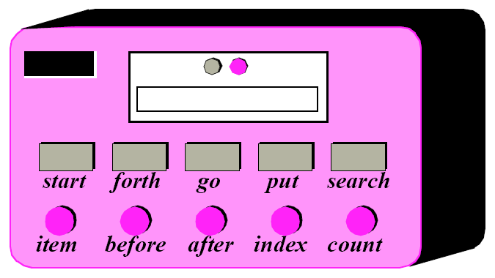
A List Object as a List Machine
Notes:
Commands include
start (move the cursor to the first element)
forth (advance the cursor one position),
Search (move the cursor to the next occurrence of the element entered into the top-left slot);
queries include
item (show in the display panel the value of the element at cursor position)
index (show the current cursor position).
Note the difference between a notion such as “cursor”, relative to the internal state and hence not directly visible, and item or index which provide more abstract, officially exported information about the state.

Slide 42
Good Class Interfaces
Command-Query Separation Principle
Good Abstraction
Good Encapsulation
How Many Arguments for a Feature
Class Size
Dealing with Abnormal Cases

Slide 43
Command-Query Separation Principle
Some side effects are harmless and necessary
Functions modify the state (affecting visible features) but then restore the original state during execution.
Change the state of the object only affects properties invisible to clients.
Foolish to dismiss side-effect-full style as thoughtless

Slide 44
Good Abstraction
Be sure what abstraction the class is implementing
Present consistent, cohesive level of abs.
Employee and EmployeeCensus
Provide services in pairs with their opposites
Turn on/off, activate/deactivate, …
Make interfaces programmatic rather than semantic when possible
Beware of erosion of the interface’s abstraction under modification

Slide 45
Good Abstraction: Employee
Class Employee {
public:
// public constructors and destructors
Employee();
Employee(FullName name, String address,
String workPhone, String homePhone,
TaxId taxIdNumber, JobClassification jobClass);
Virtual ~Employee();
//public routines
FullName GetName() const;
String GetAddress() const;
String GetWorkPhone() const;
String GetHomePhone() const;
TaxId GetTaxIdNumber() const;
JobClassification GetJobClassification() const;
…
}

Slide 46
Employee: Eroding under Maintenance
Class Employee {
public:
…
//public routines
FullName GetName() const;
Address GetAddress() const;
PhoneNumber GetWorkNumber() const;
…
bool IsJobClassificationValid(JobClassification jobClass);
bool IsZipCodeValid(Address address);
bool IsPhoneNumberValid(PhoneNumber phoneNumber);
SqlQuery GetQueryToCreateNewEmployee() const;
SqlQuery GetQueryToModifyEmployee() const;
SqlQuery GetQueryToRetrieveEmployee() const;
…
}

Slide 47
Good Encapsulation
Minimize accessibility of classes and members
Favor the strictest level of privacy that is workable
What best preserves the integrity of the abstraction?
E.g. don’t put a method into the public interface just because it uses only public methods
Don’t expose member data in public
Avoid putting private impl. details into the interface
Avoid friend classes
Don’t make assumptions about the clients, unless documented in the interface
Favor read-time convenience to write-time convenience
Be very wary of semantic violations of encapsulation
Watch for coupling that’s too tight.

Slide 48
A Math Function: What Do You Think?
nonlinear_ode
( equation_count: in INTEGER;
epsilon: in out DOUBLE;
func: procedure (eq_count: INTEGER; a: DOUBLE;
eps: DOUBLE; b: ARRAY [DOUBLE];
cm: pointer Libtype)
left_count, coupled_count: in INTEGER;
…)
Altogether 19 arguments, including:
- 4 in out values;
- 3 arrays, used both as input and output;
- 6 functions, each with 6 or 7 arguments of which 2 or 3 are arrays!

Slide 49
Why Complex to Use?
Many arguments are in out,
Must be initialized by the caller to pass a certain value and are updated by the routine to return some information.
Many arguments, both to the routine itself and to its own routine arguments, are arrays
Which again serve to pass certain values on input and return others on output.
Some arguments serve to specify the many possibilities for error processing
Stop processing, write message to a file, continue anyway…

Slide 50
How Many Arguments for a Method?
The simplicity of interfaces fundamentally determines the class’s ease of use.
Particularly true of library classes.

Slide 51
Which Ones Are Truly Indispensable?
Method print in class Document
Printing relies on Postscript
myDocument.print (
printerName,
paperSize,
colorOrNot,
postscriptLevel,
printResolution
)

Slide 52
Which Ones are Truly Indispensable?
Paper size: the routine can use as a default the most commonly available option: LTR or A4
Color: most printers are non-color.
Resolution: 600 dots per square inch may be a reasonable default for the resolution
In all these cases, you might have a mechanism supporting installation-level or user-level defaults to override the universal ones
The remaining argument - the printer name;
but might define a default printer too.

Slide 53
Operands and Options
An operand argument to a routine represents an object on which the routine will operate.
An option argument represents a mode of operation.
How to distinguish
An argument is an option if it would have been possible to find a reasonable default (assuming the client had not supplied its value).
In the evolution of a class, arguments tend to remain the same, but options may be added and removed.

Slide 54
Operands and Options: Print
All the arguments to print are options
possible exception: printerName if a default printer is not defined.
Is the implicit argument myDocument operand or option?
Notes:
the target of the call, an implicit argument (myDocument in the example) is, as all targets should be, an operand:

Slide 55
Operand Principle
Routine’s arguments should only include operands (no options).
Options to an operation are set not in calls to the operation but in calls to specific option-setting procs
myDocument.setPrintingSize ("A4")
myDocument.setColor
myDocument.print -- No argument at all
For a non-boolean type, option-setting proc takes one arg
Standard name: setPropertyName.
For a boolean proc, better to use a pair of proc
setColor and setNoColor

Slide 56
Operand Principle: Benefits
It preserves extendibility and the Open-Closed Princple
Adding more options does not need to change the interface ( which may invalidate all existing callers)
If the default value corresponds to the implicit setting, existing clients will not need to be changed.
You only specify what differs from the defaults.
Any property for which you do not need any special setting will be handled with the settings that have proved to be most commonly appropriate.
You need only pay attention to or remember the options that are relevant for your own use
Novices need only learn the essentials and can ignore any advanced properties.

Slide 57
Operand Principle: Exceptions?
Multiple creation procedures
Facilitating the client’s task by offering various ways to set up objects with non-default values.
Every creation proc must ensure the class invariant
The set of creation procs must include a minimal proc with no option arguments that sets all option values to their defaults
Some operations are often used with option-setting procs according to a standard pattern
printWithSizeAndPrinter (String printerName, SIZE_SPECIFICATION size)
Assuming the basic minimal routine is available

Slide 58
Class Size: The Shopping List Approach
Class size: supplier-side measure
The number of lines
The number of declarations and instructions
Class size: client-side - number of features
Information hiding
All features (internal size)
Only exported ones (external) size
Inheritance
Only the immediate features (immediate size)
All features (flat size)
The immediate features plus overidden/redefined (incremental size)

Slide 59
Shopping List Advice
When considering the addition of a new public feature/method, observe the following:
S1 - The feature must be relevant to the data abstraction.
S2 - It must be compatible with the other features.
S3 - It must not address exactly the same goal as another feature of the class.
S4 - It must maintain the invariant of the class.
The issue is not size per se but design quality.
Most remain small (a few to a couple dozen)
Occasionally need bigger classes (e.g., 60 or 80)

